Slide 1

TBD
Capstone Project:
Group 4
March 2023

Slide 2
Table of Content
1
Business Understanding
Data Mining and Cleaning
Data Exploration
Feature Engineering
Predictive Modeling
Data visualization
3
2
5
3
7
4
9
5
21
6
24

Slide 3

01
Business Understanding

Slide 4


Slide 5

02
Data Mining and Cleaning

Slide 6

Operate 2.0 strategy & delivery modernization
Integrated support for evolving business demands, post-modernization maintenance, and application optimization using proven methodologies, technologies, and experienced professionals for every step of the journey.
OPERATE 2.0 STRATEGY
BENEFITS OF DELIVERY MODERNIZATION
Delivering the #1 Talent Experience
Establish clear owners to grow Operate as a business and build a pipeline of talent and leaders
Leadership & Organization
COST SAVING
ENHANCED QUALITY
Driving Earnings Centricity
Build tools and processes to properly solution and price deals and measure the business
Financial Management
REPEATABLE APPROACH
RETURN ON INVESTMENT
EMBEDDING The Thrill of Delivery
Make investments to standardize and modernize delivery
Delivery Modernization
REDUCED RISK
ENHANCED
INTEROPERABILITY

Slide 7

03
Data Exploration and
Feature Engineering

Slide 8
AMS delivery approach
We utilize a simple and lean delivery approach framework that empowers the ongoing sustainment experience and goes beyond keeping the lights on. This approach is easy to adopt, user friendly, with an emphasis on standardization and modernization, enabling continuous process improvements plus encouraging and bringing to life innovative capabilities.
SOLUTION DESIGN
INITIATE
TRANSITION
STABILIZE & OPTIMIZE
SUSTAIN & INNOVATE
Transition Manager R&R
Execution
Delivering Client Value
Design and build the managed services solution
Plan and assemble service delivery resources to achieve value objectives
Acquire knowledge and deploy a service delivery model
Drive rapid stabilization of acquired services and target quick efficiency gains
Deliver consistent, high-performance services and maximize value delivery
Transition Managers work directly with the senior manager (CEL) and manager (DL) on the Operate engagement supporting Application Management Services to execute all tasks as outlined in the transition and KT plans
TRANSITION MANAGER
Transition Managers must possess excellent communication skills (both written and verbal) with leaders at all levels and be adaptable to change, as needed.
Transition Managers are responsible for planning and overseeing the transfer of key information necessary to support the solutions deployed into production. This includes operational readiness, support documentation and related tools & assets. Transition can be from the client, outgoing vendor or Deloitte implementation team.
Transition managers will engage with the senior manager/CEL on the engagement for guidance, direction and sign off/final approval on all tasks outlined in the transition and KT plan
MUST DO
LEVERAGE
Build & execute transition & KT plan, kickoff deck, status report, and set meeting cadence
Ensure the operations manual/runbook is drafted and finalized by CEL/DL
Establish AMS stabilization
Review Transition L&D training materials
Leverage Governance Model & ITIL Process
Utilize OperateEdge Platform and Transition Templates to complete all required tasks
Transition managers may have access to client confidential information. As part of any engagement, you are legally bound to maintain the confidentiality of all client data.

Slide 9

04
Predictive modeling

Slide 10
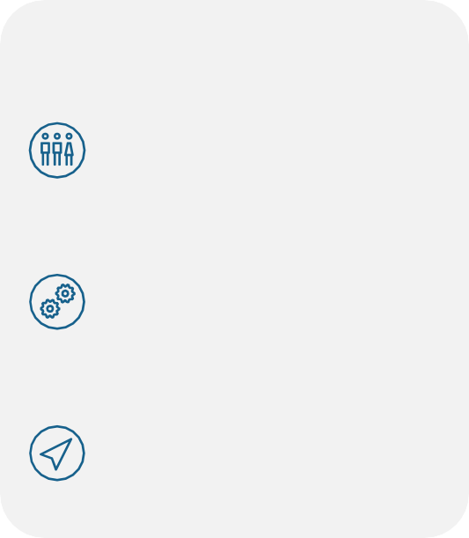
Internal vs external transition
Transition of applications in scope and service delivery processes are performed in conjunction with the client, vendor or Deloitte Implementation team. Staffing a dedicated transition manager is essential in providing neutrality, minimizes disruption and ensures a seamless and effective transition
INTERNAL TRANSITION
PEOPLE
Synergies between Client, Vendors, Implementation and Operate teams
Shared resources and capabilities from AMS to project
Knowledge retention of solution
Resource continuity post deployment of the solution
PROCESS
End to end Operate support services
Proven approach and expertise for incumbent transition
Minimized service disruption through one time transitioning/introduction of new service provider(s)
TECHNOLOGY
Expedited remediation of existing technology coverage gaps and service improvements
Commitment to leverage capacity for enhancement work
EXTERNAL TRANSITION
PEOPLE
Align team members from client or vendor with the Deloitte Team members
Expectations must be set appropriately with the client or vendor, confirming participation, schedule for all team members
PROCESS
Effort must be taken to ensure that complete and effective knowledge transition happens between Deloitte and client, or vendor
Client/Vendor must assist Deloitte to build capability (e.g., documentation), process and demonstrate its effectiveness
TECHNOLOGY
Assess technology coverage gaps and service improvements
Discuss additional enhancements, if needed, to support services and performance management requirements
How will we staff transition mgrs.?
Organize
Utilize Mercury reports in collaboration with PMD/SM leaders to assess AMS new business or I to O deals sold and, in the pipeline
Operate
Align PMaaS team members to upcoming opportunities
Confirm timeframe/hours allocated for each engagement
Observe
Monitor tasks and workload assigned to each transition
Track & maintain a log of lessons learned –specifying differences amongst each package
* Assignments will vary in hours based on the project, but the average timeframe/FTEs will be no less than ½ FTE.

Slide 11



Transition Management
Formulate a transition strategy for business-as-usual support for client/vendor and ensured continuity of service. The transition process is managed in waves, with a focus on efficiency and effectiveness.
Governance & Management
Leadership alignment to future state support strategy
High-level service support model design
Service level objectives and performance measurement
Decision rights and change control
Organization & People
Target AMS operating model, sourcing options
Resource capability, knowledge, talent and skills assessment
Resource requirements and sizing
Workforce transition strategy
Training, re/up-skilling, and readiness
Process & Delivery
Service desk and incident management
Release management
Change and enhancement request management
Operational performance measurement
Service Technology
Case management / service request enabling technology
Documentation repository and knowledge base
Operational reporting and performance measurement
Audits, security, and quality assurance

Slide 12
Transition management activities
Pre-Planning
Planning
Knowledge Acquisition
Shadow
Reverse Shadow
Exit Transition
Steps:
Current-state assessment
Future-state definitions
Work streams:
Service delivery model
Planning and process management
Contract management
Application management
Exit Criteria –
Leadership team deployed
SMEs engaged
Support scope confirmed
Transition governance
Resource planning and onboarding
Assess SMA and third-party availability
Perform connectivity setup
Confirm support performance capability
Transition operation manual
Exit Criteria –
SMEs engaged
Plan approved
Communications launched
People-change launched
Phase exit criteria
Exit Strategy confirmed
Perform knowledge transition
Knowledge harvesting, with sessions recorded and stored for cascaded training
Relocate support team (onsite and offshore)
Assess and track access controls
Establish Application Understanding Documents (AUDs)
Exit Criteria –
Knowledge acquired OR gap closure plan in place
KT scheduled
Sessions held and completed
Knowledge transferred
Understanding demonstrated
Shadowing, with guided perform (on-the-job training)
Identify areas to refine support delivery
Confirm support performance
Monitor and refine support delivery and support team
Define deliverable acceptance and transition exit criteria and scorecard
Exit Criteria –
Knowledge acquired OR gap closure plan in place
KT scheduled
Sessions held and completed
Knowledge transferred
Reverse shadowing, with assisted/parallel perform
Orient support team to client service-level requirements
Commence status reporting
Introduce performance metrics
Review operational readiness validation scorecard and obtain client approval/sign-off
Exit Criteria –
Knowledge transferred
Understanding demonstrated
Provide application support onsite and offshore
Focus support on “how to” and break fix
Finalize maintenance roles, activities, and performance metrics
Sign-off transition phase when all waves are in steady phase
Exit Criteria –
Meeting or exceeding SLAs
Delivering POR on schedule
Reporting service delivery performance
Measuring, managing and improving service quality
Operationalizing new capabilities (e.g. Modernization; End-to-End Testing)
Deploying new methods (e.g. Agile and DevOps)
Transition Phase can be a minimum of 4 weeks to 4 months prior to Go Live

Slide 13

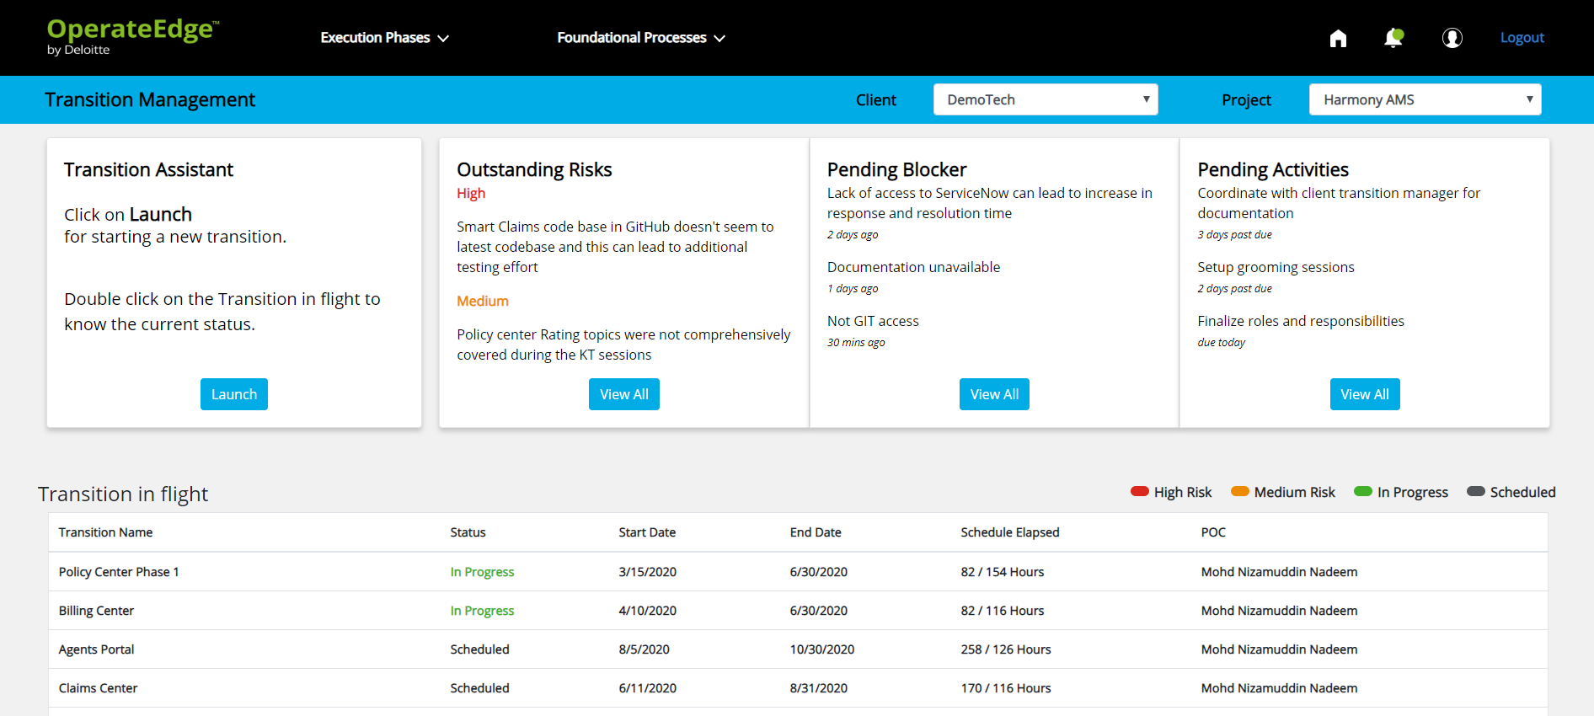
Using OperateEdge to support transition management
OperateEdge™ is Deloitte’s proprietary intelligence suite leveraging AI technologies for IT Operations, enabling continuous monitoring throughout the lifecycle, and empowering teams to leverage feedback in real-time to address unresolved issues. OperateEdge will be used during the transition phase for all internal AMS engagements
OperateEdge™ Delivery Management
Project Management Hub
Learning Center
Transition Management Center
Transition Managers will utilize the OperateEdge platform to build a transition plan, track progress, manage risks and automatically flag potential blockers for all implement to operate transitions
Business Metrics Insights
Transition Management
Knowledge Center
Risk
Management
Delivery Management
App Dev Hub
Initiate
System Management
Service Management
Data Operations Hub
Sustain
&
Innovate
Solution Design
Incident Tracking
Select Client and Project from given list
Create new transitions and use given templates to quickly create new tasks
Log Analysis
Problem
Insights
Batch Operations
Stabilize & Optimize
Transition
Service Req
Insights
Key Features
Streamlined transition plans for similar engagements
Better risk management
Automated tracking of transition progress
Web Analytics Insights
Change Req
Insights
Infrastructure Hub
Incident Management
License & Certificates Center
Incident Forecasting
Driven by Innovation and Automation
Prescriptive
Artificial Intelligence
Predictive
Transition Management
Self-healing
Machine Learning
Play OperateEdge demo video here
Cognitive
Provides key pending blockers and activities with automation capabilities
View summary of all transitions logged on the tool

Slide 14
Governance & Management: governance structure
Governance Level
Role
Description of Authority
Frequency
Strategic Guidance
Executive Committee
Program/project sponsorship, strategic direction, objectives, roadmap, budget
Strategic input and guidance for the strategic direction of HR and digital technologies. Manage executive stakeholder engagement across the organization (e.g., Approve enterprise investment in HR technology; define scope of services for HR Delivery Strategy)
[Example: Quarterly]
Harder Decisions
Fewer issues
Executive
Decisions
Management Committee
Executive oversight, strategic change
Decisions impacting program/project strategy enablement, objectives and direction (e.g., manage escalations; prioritize efforts within projects; enable strategy through roadmap)
[Example: Monthly]
Operational
Decisions
Core Teams
Program governance, operational leadership
Approach, timeline, ad hoc requests and prioritized requests within thresholds; deadlines not affecting deployment dates (e.g., prioritize continuous improvement projects within thresholds, provide oversight for break-fix requests)
[Example: Monthly]
Easier Decisions
More issues
Solution Delivery
Product Teams
Execution of activities and deliverables
Triage ad hoc break-fix requests; execution of prioritized requests against solution specifications (e.g., implement break-fix requests, technical development of in-queue priority)
[Example: Weekly]
The client's governance structure will determine how requests are approved, prioritized and managed on an ad hoc basis. The request size, priority and type will influence which governing body is the decision maker. The governance structure will also determine meeting structure, attendees and cadence for each committee

Slide 15

Governance & Management: scope of services
OPERATE SUPPORT LEVELS
Level 0 and Level 1 support levels are serviced by the client and/or vendor. Operate AMS team members will work with the client to address additional enhancements / projects identified
Level 0
X
Super Users and Self Help ○ Online help/documentation ○ Address “how to” questions ○ End user training ○ Business requirements
Level 1
X
Help Desk ○ Incident creation ○ Incident routing/queues ○ Incident prioritization ○ Incident monitoring
Deloitte Operate AMS team members own supports services level 2 – 4 and tracked through SLAs / SLOs and capacity
Level 2
Application Operations ○ Triage ○ Break fix ○ Service request coordination ○ Incident management ○ Change management ○ Problem management ○ Access provisioning and security
Level 3
Application Support ○ Configuration ○ Integrations ○ Patch impact analysis ○ Release management ○ New functionality adoption ○ Minor enhancements ○ Vendor coordination
Models include capacity-based, project-based, or staff augmentation for specific activities
Level 4
Projects ○ Major enhancements ○ Deployments
We only support infrastructure on cloud as part of Operate services
Cloud Infrastructure & Database
Cloud Infrastructure, Database, and Oracle Product Support ○ Manage user subscription for additional resources analysis ○ Environment management ○ System admin activities ○ Cloud infra support

Slide 16
Governance & Management: service level objectives/agreement
An agreement between HR Operations and its customers that documents and establishes acceptable service levels to be continuously measured and monitored to confirm commitments to the business are maintained
Service Level Description | Response Target* | Resolution Target*
Priority 1 / Critical | 15 Minutes | 4 Hours
Priority 2 / High | 1 Business Hour | 8 Business Hours
Priority 3 / Medium | 1 Business Day | 3 Business Days
Priority 4 / Low | 1 Business Day | 5 Business Days
Measurement Tools
Metric
A metric is a numerical standard of measurement that enables organizations to quantify an activity or event. Metrics provide actionable information to help leaders make key decisions and investments
Example = Number of cases received today
Key Performance Indicator (KPI)
A KPI is a metric that provides a specific measure of performance to evaluate the success of an activity or progress toward strategic goals. KPIs form the basic building blocks from which scorecards / dashboards are built
Example = The average call time of 9 minutes is better than target

Slide 17
Organization & People: resource summary
Group | Responsibilities | Required FTE | CLIENT Resource(s) | Skills Gap | Resource Gap
Application Owner | Application Owner – Manage Workday application, define scope and requirements, manage both technical and functional teams | 0.10 - 0.25 FTE
Functional | Application Support Lead - Project manage, manage functional area/team, define requirements; function as Application Support | 0.15 - 0.25 FTE
 | Release Manager - Managing the life-cycle of release management activities | 0.15 - 0.25 FTE
 | Application Support – Maintain Workday applications including break/fix, enhancements, testing, and updating requirements and documentation | Core HR – 0.25 - 0.50 FTE Comp – 0.25 – 0.50 FTE Advanced Comp – 0.25 FTE (during peak times) Talent and Performance – 0.25 FTE (during peak times) Recruiting - 0.25 – 0.50 FTE Absence – 0.25 – 0.50 FTE Time Tracking – 0.5 FTE Payroll – 0.5 – 1.0 FTE Benefits – 0.25 - 0.50 FTE (.50 FTE for peak times) Financials – 2.0 FTE
Technical | Integration Lead – Manage, monitor and control data interfaces | Integration – 0.25 FTE
 | Integration Support – Maintain integrations including break/fix, enhancements, testing, and updating requirements and documentation | Support – 1.75 - 3.75 FTE
 | Security & Compliance Lead – Ensure compliance of policies, procedures and regulations | Security Lead – 0.10 FTE
 | Security Configurator - Configure Security rules and settings in the system | Configurator – 0.15 FTE
 | Security Grantor - Ensure right access provided to the team | Grantor – 0.10 - 0.25 FTE
 | Report Writer – Manage custom and standard SF reports (including Prism) | Report – 2.0 FTE
Common Terminology
Client Experience Lead (CEL/SM)
Delivery Lead (DL/Mgr.)
AMS Delivery Team (functional/technical)
Lead Engagement Partner (LEP)
Lead Client Service Partner (LCSP)
Sample

Slide 18
Process & Delivery: knowledge transfer shadow
Establish shadow process, activities, roles and responsibilities outlined in KT plan
Establish and confirm Shadowing logistics
Kickoff KT:Shadow Plan with AMS Team
Monitor the process and technology specific activities for each application
Update KT:Shadow Plan
Maintain risk/issues log and mitigation plans
Review readiness Criteria
Confirm project team readiness for Reverse Shadow activities
Key Tasks
Readiness Criteria
Gained experience on service delivery activities and business process areas
Participate in month end and quarter end activities. Perform exercises for critical activities –i.e., Year end and release management.
Review of historical incidents/SRs completed
Completion of daily review meetings on P1 and P2 tickets
Access to production systems for all applications
>30% tickets resolved by Deloitte independently during last week of Shadow.
Transition Manager will plan out the list of participants, modules and activities included in knowledge transfer based on the inputs received from the CEL/DLs. Keep in mind, in some cases it helps to invite multiple SMEs (functional and technical) into one session.
CEL/DLs are responsible for a) identifying all available documentation – ideally on MS TEAMS b) prepare brief presentation/kickoff on the chosen knowledge areas c) be ready to answer questions related to KT tasks and d) identify the cadence for updating the plan.
Transition managers will help schedule knowledge transfer sessions, as needed, in accordance with the KT plan and tasks associated. Session vary from 1 – 3 hours per session depending upon the KT topic/module.
Knowledge transfer sessions should be recorded and stored on the project MS TEAMS site for further review, as needed

Slide 19
Process & Delivery: knowledge transfer reverse shadow
Establish Reverse Shadow process, activities, roles and responsibilities outlined in KT plan
Deloitte team will begin fixing low, medium, high and critical priority tickets
Update the KT:Reverse Shadow Plan including contingencies as required
Maintain risk log and manage risks and issues
Measure the effectiveness of Reverse Shadow and resolve any gaps
Start measuring SLA/SLOs for the tickets handled by Deloitte AMS Team
Confirm the overall readiness for AMS steady state
Key Tasks
Readiness Criteria
Transition Manager will discuss and document the list of resources needed to mitigate risks during the transition phase. Any changes to the project team will be decided by the Deloitte PMD, SM and DLs on the engagement.
All Critical risks/issues addressed and documented
All open tickets/queues are transferred over to Deloitte AMS project team
Required application access and connectivity is tested and operational
Advanced level of knowledge and proficiency obtained (>90% tickets resolved by Deloitte AMS Team independently during last one to two weeks of reverse shadow)
Finalize and signoff on the clients’ operations manual/runbook
Transition Manager will diligently address any internal or external risks related to availability of stakeholders, SME, and current support team members during the transition phase.
Transition Managers must report all risks, severity and mitigation plan within the weekly transition status reports
Knowledge transfer sessions should be recorded and stored on the project MS TEAMS site for further review, as needed

Slide 20
Process & Delivery: standard operating procedures/runbook
Standardized processes help to manage information flow, from change to problem management, both internally and externally to the client’s systems
 | Case/Incident Management | Restores normal service operations as quickly as possible and minimizes the adverse impact on business operations
 | Problem Management
 | Change Management | Ensures standardized methods and procedures are used for efficient handling of all changes to minimize the impact of change-related incidents and improve operations
 | Configuration Management | Maintains the alignment of what is requested to be designed in the change request and what is built, tested, and accepted
 | Release Management | Ensures effective management of weekly, bi-annual, and regular releases beginning with an evaluation of impact of the release, planning for release, regression testing/trouble-shooting and validating changes in production
Key Features
Enables all customer requests (issues, enhancements, or questions) are managed to completion
Facilitates adherence to service-level objectives (SLOs)
Focuses on end-to-end service management
Supports quality initiatives
Refines through delivery experience
Facilitates cost-effective service delivery

Slide 21


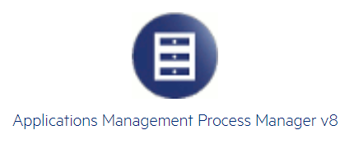


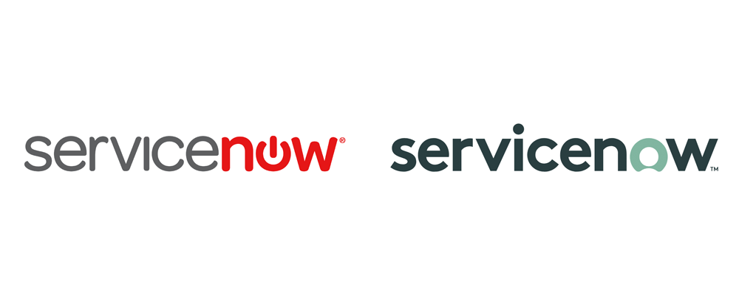
Service Delivery: incident/case Management
Commonly used AMS ticket platforms to log breaks/fixes and/or new configuration changes

Slide 22

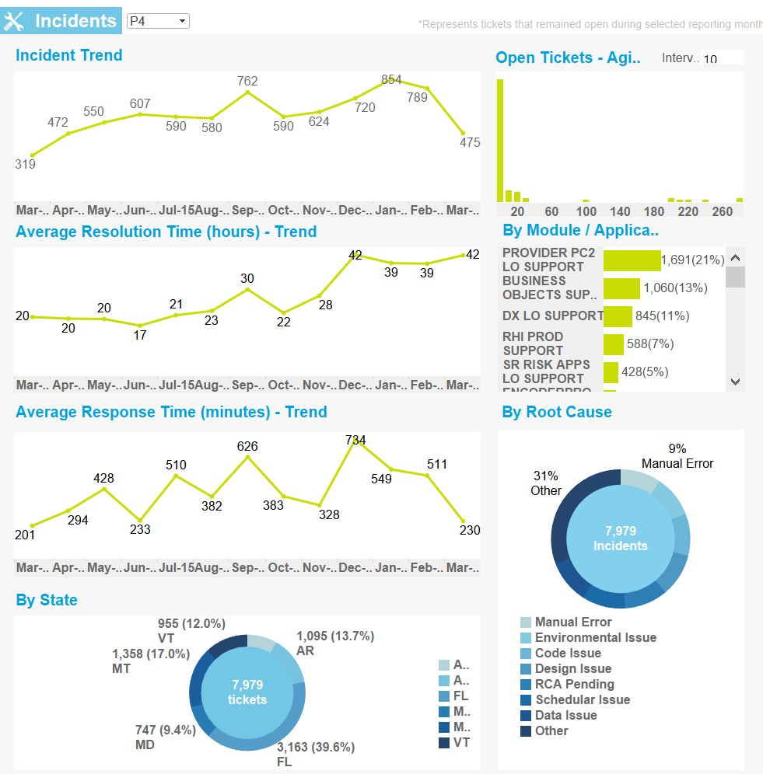




Service Delivery: performance management
Determine ticket management platform, procedures and escalation process used for logging an incident, tracking cases, regulate ownership, reporting, monitoring trends and identifying gaps as per the SLA/SLO
Collect
Regularly capture all data relevant to an engagement
Analyze
Metrics analyzed and outliers excluded, right samples considered
Publish
Publish insights and action items
Improve
Use Insights & actions to monitor trends and identify improvement opportunities
SERVICE LEVEL AGREEMENT/ OBJECTIVE
DATA SOURCE
A negotiated performance metric applied to an aspect of the services
Provides applicable data, tools, software, or other source of origin gathering data
PERFORMANCE MANAGEMENT
TARGET PERFORMANCE LEVEL
Tool that measures and reports AMS project team performance
(e.g., incident management tool)
Performance metrics or requirements by which Deloitte’s performance is measured

Slide 23

05
Data Visualization

Slide 24


Transition management templates
Please use the links below to access the Transition toolkit………..
1
Transition Management Checklist
Link
2
Transition Management Plan
Link
3
Transition Management Knowledge Transfer (KT) Plan Template
Link
4
Transition Management Kickoff Deck Template
Link
5
Transition Management Status Report Template
Link
6
Transition Management Risks & Mitigation Log Template
Link
7
Additional Resources
Link

Slide 25

06
Project Team

Slide 26
Governance & Management: governance structure
Governance Level
Role
Description of Authority
Frequency
Strategic Guidance
Executive Committee
Program/project sponsorship, strategic direction, objectives, roadmap, budget
Strategic input and guidance for the strategic direction of HR and digital technologies. Manage executive stakeholder engagement across the organization (e.g., Approve enterprise investment in HR technology; define scope of services for HR Delivery Strategy)
[Example: Quarterly]
Harder Decisions
Fewer issues
Executive
Decisions
Management Committee
Executive oversight, strategic change
Decisions impacting program/project strategy enablement, objectives and direction (e.g., manage escalations; prioritize efforts within projects; enable strategy through roadmap)
[Example: Monthly]
Operational
Decisions
Core Teams
Program governance, operational leadership
Approach, timeline, ad hoc requests and prioritized requests within thresholds; deadlines not affecting deployment dates (e.g., prioritize continuous improvement projects within thresholds, provide oversight for break-fix requests)
[Example: Monthly]
Easier Decisions
More issues
Solution Delivery
Product Teams
Execution of activities and deliverables
Triage ad hoc break-fix requests; execution of prioritized requests against solution specifications (e.g., implement break-fix requests, technical development of in-queue priority)
[Example: Weekly]
The client's governance structure will determine how requests are approved, prioritized and managed on an ad hoc basis. The request size, priority and type will influence which governing body is the decision maker. The governance structure will also determine meeting structure, attendees and cadence for each committee

Slide 27












Transition training materials
Learn key principles, skills, tools and best practices needed to drive a successful transition to Application Management Services (AMS)
Set up your Cura profile
Watch Hybrid Project Management for PMs on Udemy
Complete Microsoft Visio Essentials Training if applicable
Watch the “Introduction to Operate” Video on Cura
Download Microsoft Project from the software catalog
Complete Powerpoint for non-designers, if applicable
Download and review the “Operate Delivery” PPT on Cura
Complete MS Project Essentials Training, if applicable
Explore Deloitte Toolbars
Watch OperateEdge Overview and Demo
Download Microsoft Visio from the software catalog
Explore Brand Space

Slide 28


